Slide 1

Perancangan Sistem Pemrograman
UML Activity Diagrams and Modeling
Prepared by Frans Panduwinata, S.Kom, M.T

Slide 2

Basics
The easiest way to visualize an activity diagram is to think of a flowchart of a code.
The flowchart is used to depict the business logic flow and the events that cause decisions and actions in the code to take place.
Activity diagrams represent the business and operational workflows of a system.

Slide 3
Basics (cont)
Basic UML activity diagram notation is illustrating an action, partition, fork, join, and object node.
In essence, this diagram shows a sequence of actions, some of which may be parallel.
Most of the notation is self-explanatory; two subtle points:
  Once an action is finished, there is an automatic outgoing transition
  The diagram can show both control flow and data flow

Slide 4



Elements
Element and its description | Symbol
Initial activity: This shows the starting point or first activity of the flow.
Activity The activity itself.
Transition

Slide 5
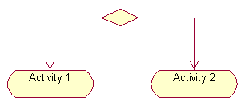
Elements (cont)
Element and its description | Symbol
Decisions: Similar to flowcharts, a logic where a decision is to be made.

Slide 6
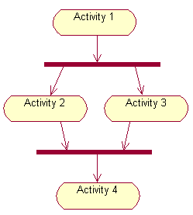
Elements (cont)
Element and its description | Symbol
Concurrent activities: Activities that occur simultaneously or in parallel. For example, listening to the lecturer and looking at the blackboard is a parallel activity.

Slide 7

Elements (cont)
Element and its description | Symbol
Final activity: The end of the Activity diagram is shown by a bull's eye symbol, also called as a final activity.

Slide 8
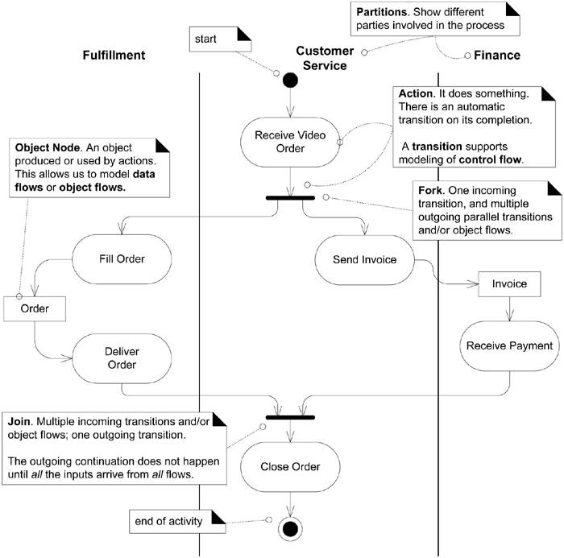
Examples

Slide 9
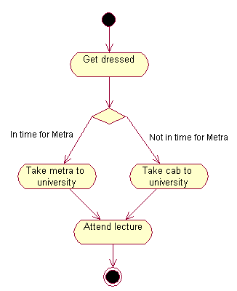
Examples (cont)
Let us consider the example of attending a course lecture, at 8 am.

Slide 10
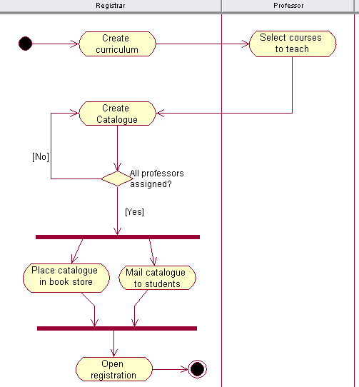
Examples (cont)
Activity diagram with swimlane.

Slide 11
How to Apply Activity Diagrams?
Business Process Modeling
Example:
In the express parcel shipping business.
  There are many parties involved (customer, driver, …) and many steps.
  Although this process can be captured in text (in use case text), in this case activity diagrams are a great example of pictures being worth a thousand words.
  Using activity diagrams to understand their current complex business processes by visualizing them.

Slide 12
How to Apply Activity Diagrams? (cont)
Business Process Modeling (cont)
Example:
In the express parcel shipping business.
  The partitions are useful to see the multiple parties and parallel actions involved in the shipping process, and the object nodes illustrate what's moving around.
  After modeling their current process they visually explore changes and optimizations.

Slide 13
How to Apply Activity Diagrams? (cont)
Data Flow Modeling
  Starting in the 1970s, data flow diagrams (DFD) became a popular way to visualize the major steps and data involved in software system processes.
  This is NOT the same as business process modeling; rather, DFDs were usually used to show data flows in a computer system, although they could in theory be applied to business process modeling.
  DFDs were useful to document the major data flows or to explore a new high-level design in terms of data flow.

Slide 14
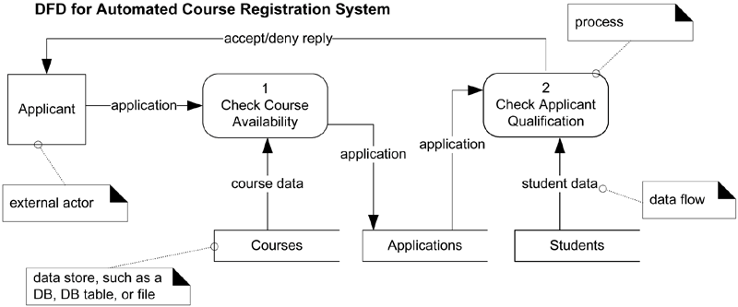
How to Apply Activity Diagrams? (cont)
Data Flow Modeling (cont)
  Classic DFD in Gane-Sarson notation

Slide 15
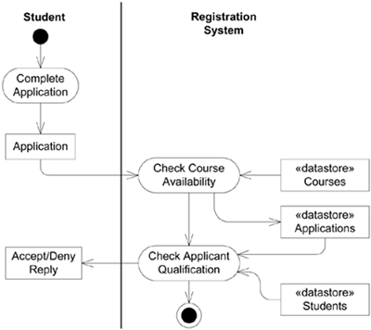
How to Apply Activity Diagrams? (cont)
Data Flow Modeling (cont)
  Applying activity diagram notation to show a data flow model

Slide 16
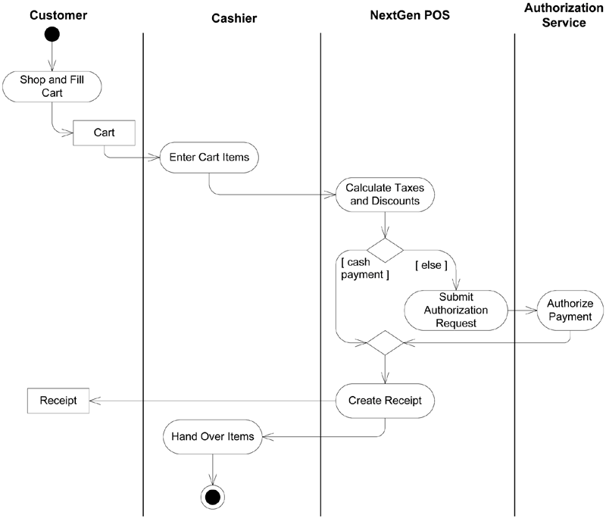
Example: NextGen Activity Diagram
Modeling the Process Sale use case with an activity diagram

Slide 17
Case Study
We had defined the following use cases for the Courseware Management System:
  View courses
  Manage topics for a course
  Manage course information
  View course calendar
  View tutors
  Manage tutor information
  Assign courses to tutors

Slide 18
Case Study (cont)
As part of managing the course information, the course administrator carries out the following activities:
  Check if course exists
  If course is new, proceed to the "Create Course" step
  If course exists, check what operation is desired—whether to modify the course or remove the course
  If the modify course operation is selected by the course administrator, the "Modify Course" activity is performed
  If the remove course operation is selected by the course administrator, the "Remove Course" activity is performed

Slide 19
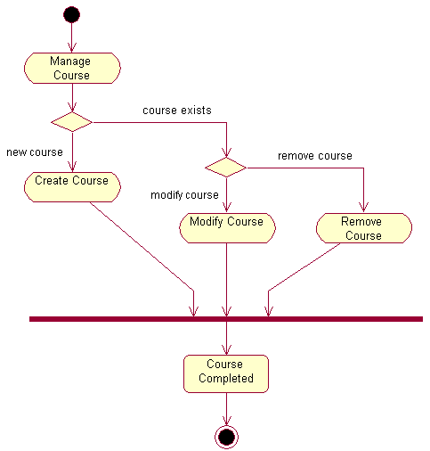
Case Study (cont)
Activity diagram for the "Manage course information" use case.
State

Slide 20
Exercises
Create activity diagram for the remaining use case in case study with your project team includes:
  View courses
  Manage topics for a course
  View course calendar
  View tutors
  Manage tutor information
  Assign courses to tutors

